Slide 1
Group 8
To predict the Dogecoin price by Sentiment Analysis on DogeCoin Tweets
Arpita Choudhury
Celine Hsu
Shayna Lue
Zhiyi Tan

Slide 2
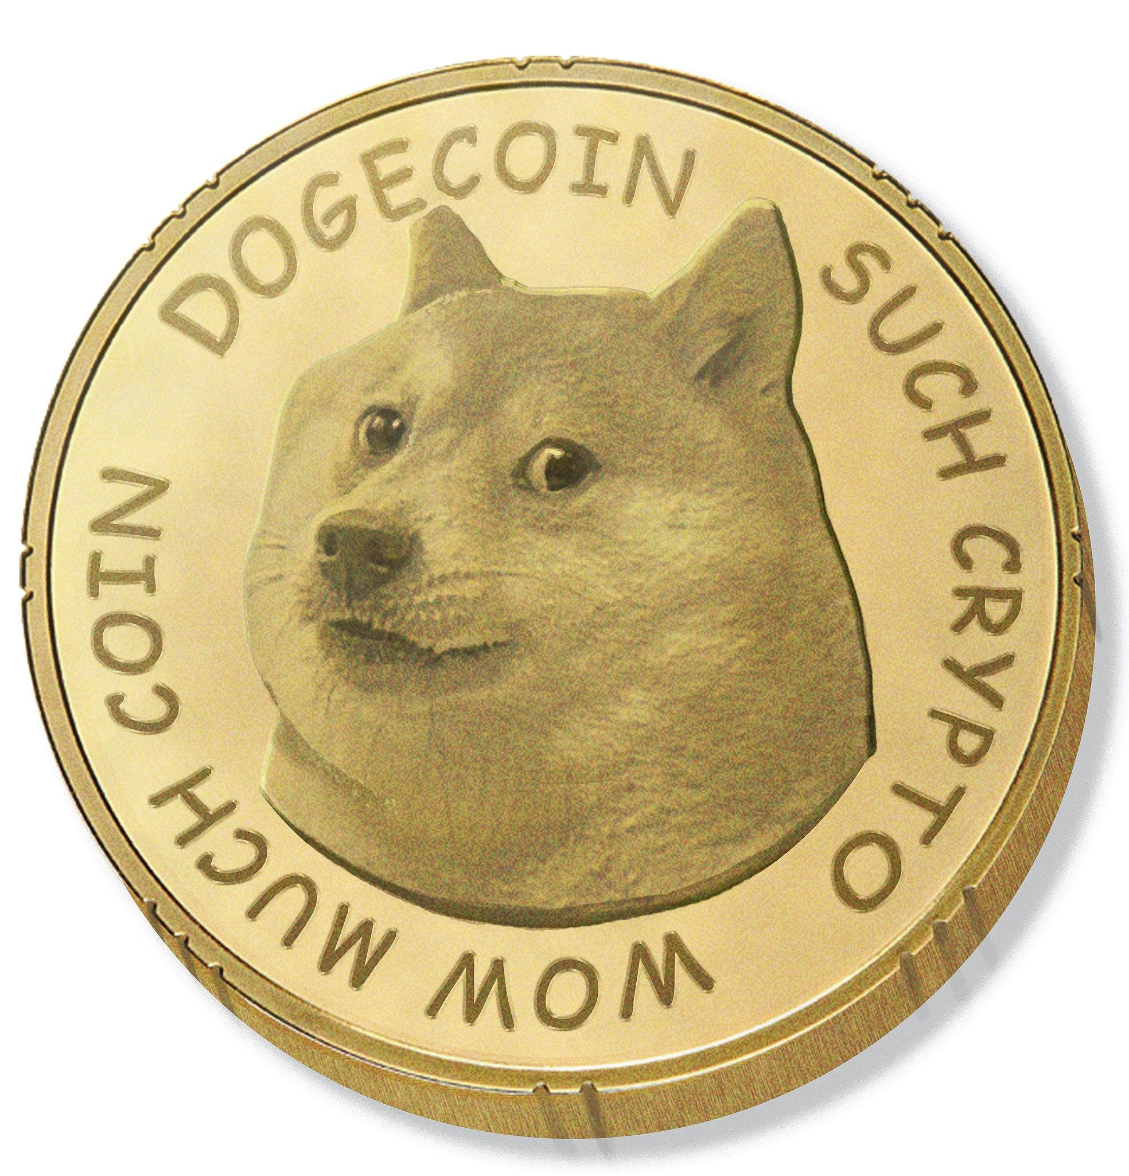
Why Dogecoin ?
The second quarter of 2021 has proved to be a major growth period for Dogecoin but very few significant studies are available yet
The fact that Dogecoin has witnessed huge growths in terms of volume and value, we decided to focus our project to predict the price of Dogecoin
Knowledge of price movement by a fraction of a second can lead to high profit that the investors can make through this currency
Help determine the value of a company by taking tangible and intangible factors into account and also find out if the currency is undervalued or not
1
Notes:
First of all reason why we want to focus on cryptocurrency is because ..cryptocurrency is becoming more popular every year as technology continues to advance.
And reason we chosen dogecoin is because .

Slide 3

Project Statement
Apart from the publicly available market data, Twitter, especially Elon Musk’s tweet, has been noticed to have a strong influence on dogecoin prices and trading volume
We decided to utilize social signals and sentiment analysis for the prediction of prices of this cryptocurrency
2

Slide 4
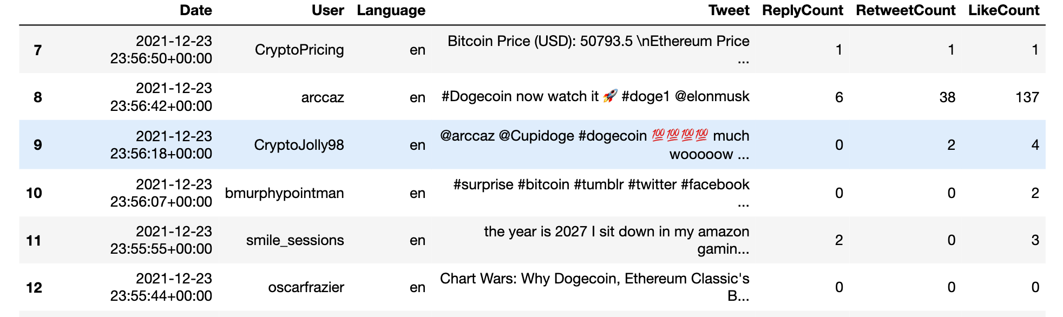

Twitter Data
Keyword : ‘dogecoin’
Date: 12/01/2021-03/31/2022 (4 months)
Language : English
Including: User, Post, Date, Retweet Num., Reply Num., Like Num.
Total Tweets : 531,967
3

Slide 5

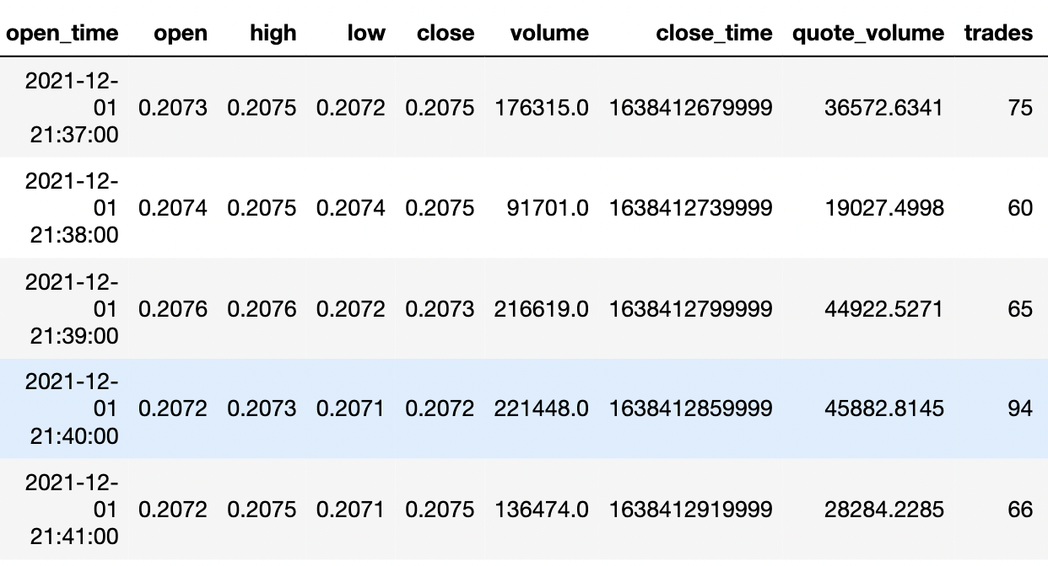
Market Data
Date: 12/01/2021-03/31/2022 (4 months)
Source : Binance.com
4

Slide 6
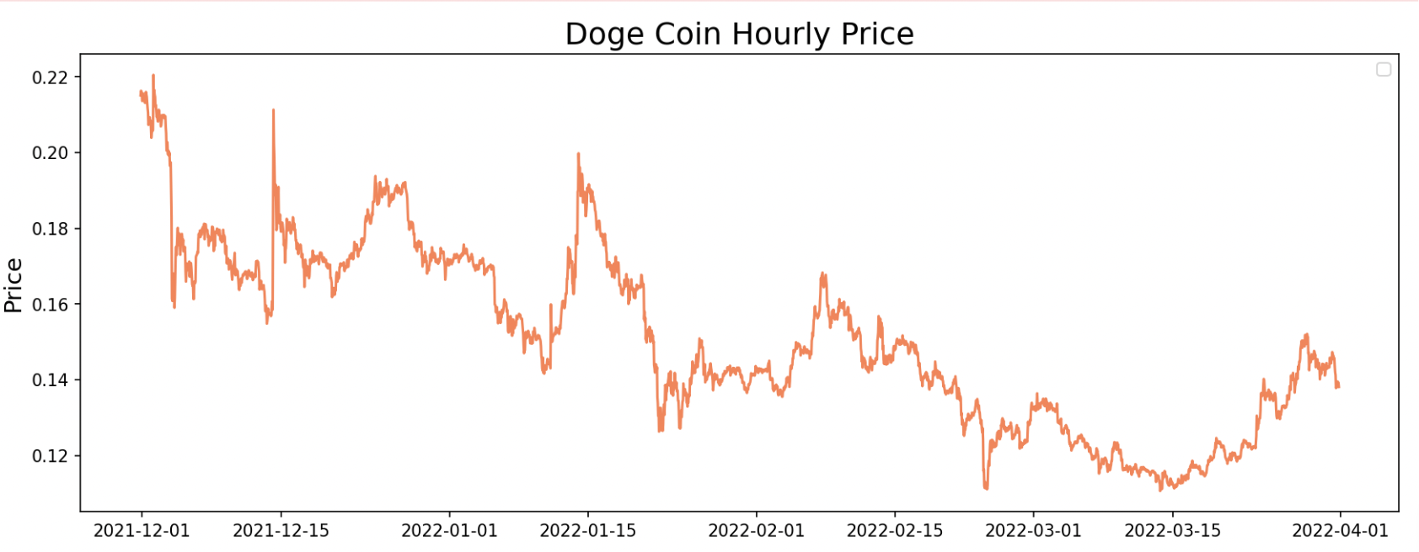
Market Data
5

Slide 7

Workflow design
Crawl Twitter Data
2021/12-2022/03
Sentiment Analysis
(TextBlob, Vader)
Training 40%
Visualization
Grouping into
Hourly Data
Merge
Selecting
Variable
LSTM
Testing
30%
RMSE
Validation
30%
Market Data
2021/12-2022/03
6

Slide 8
Result - Measurement LSTM with RMSE
 | Variable input in LSTM | RMSE of Validation Data
1 | Close Price (Baseline) | 0.00576
2 | Close Price + Score of TextBlob | 0.02327
3 | Close Price + Vader Score | 0.00464
4 | Close Price + Score of TextBlob x Retweet Count | 0.01625
5 | Close Price + Vader Score x Retweet Count | 0.01945
7

Slide 9
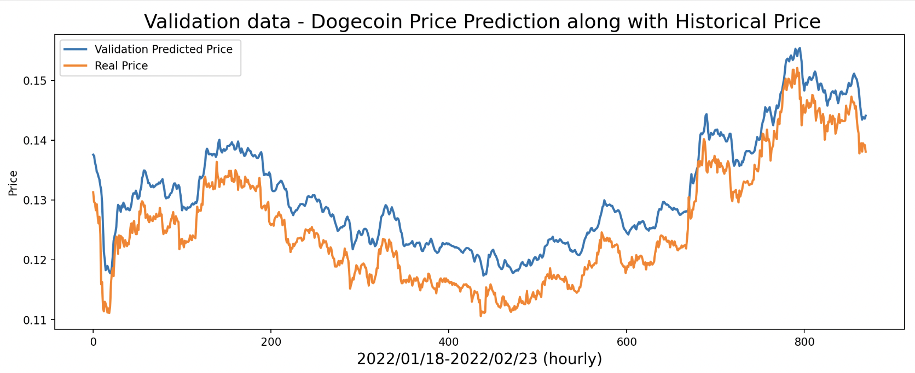
Measurement Time Series LSTM with Figures
2022/02/23 - 2022/03/31
Method 1: RMSE : 0.0576
8

Slide 10
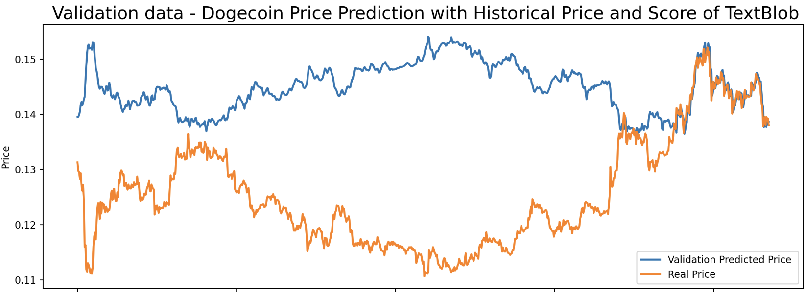
Measurement Time Series LSTM with Figures
2022/02/23 - 2022/03/31
Method 2: RMSE : 0.02327
9

Slide 11
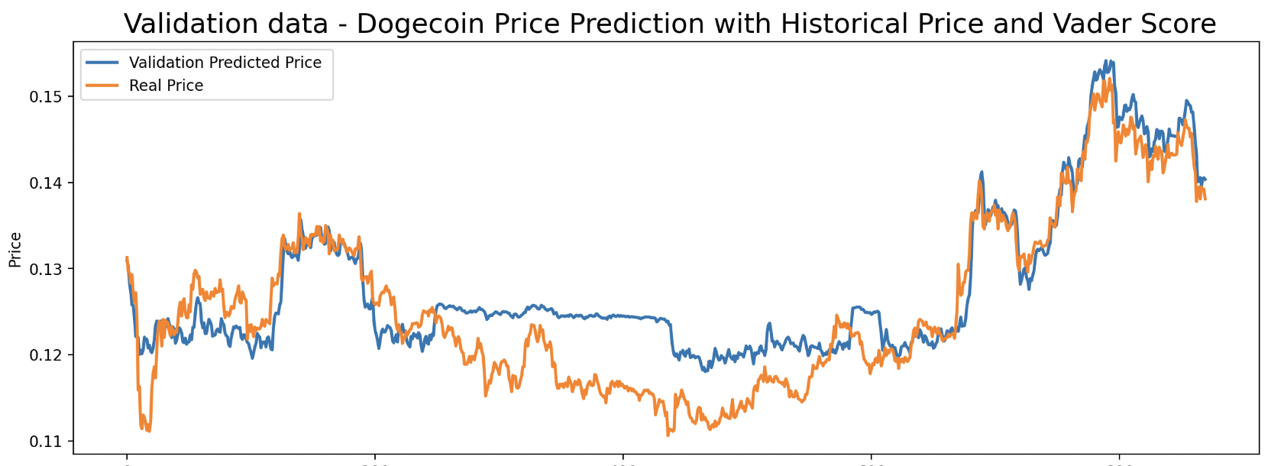
Measurement Time Series LSTM with Figures
2022/02/23 - 2022/03/31
Method 3: RMSE : 0.00464
10

Slide 12
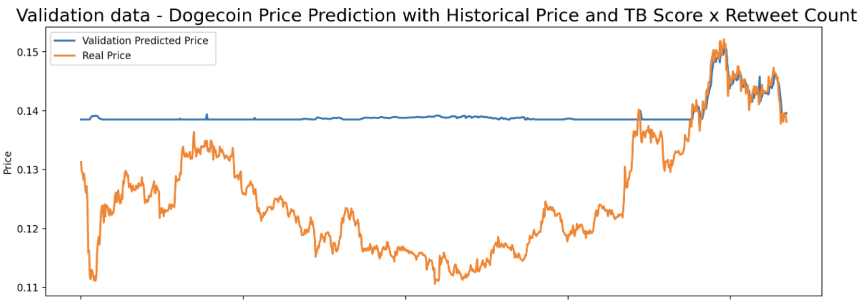
Measurement Time Series LSTM with Figures
2022/02/23 - 2022/03/31
Method 4: RMSE : 0.01625
11

Slide 13
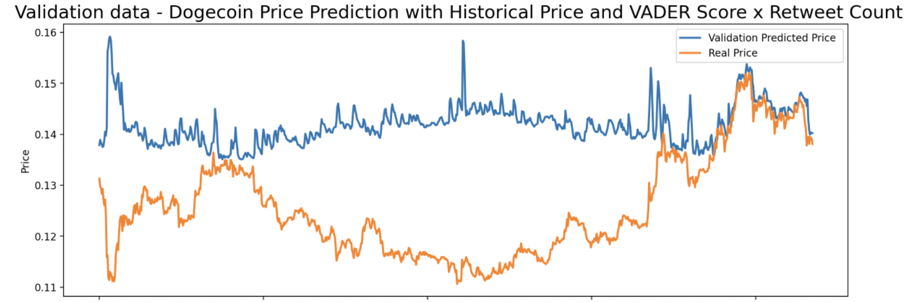
Measurement Time Series LSTM with Figures
2022/02/23 - 2022/03/31
Method 5: RMSE : 0.01945
12

Slide 14
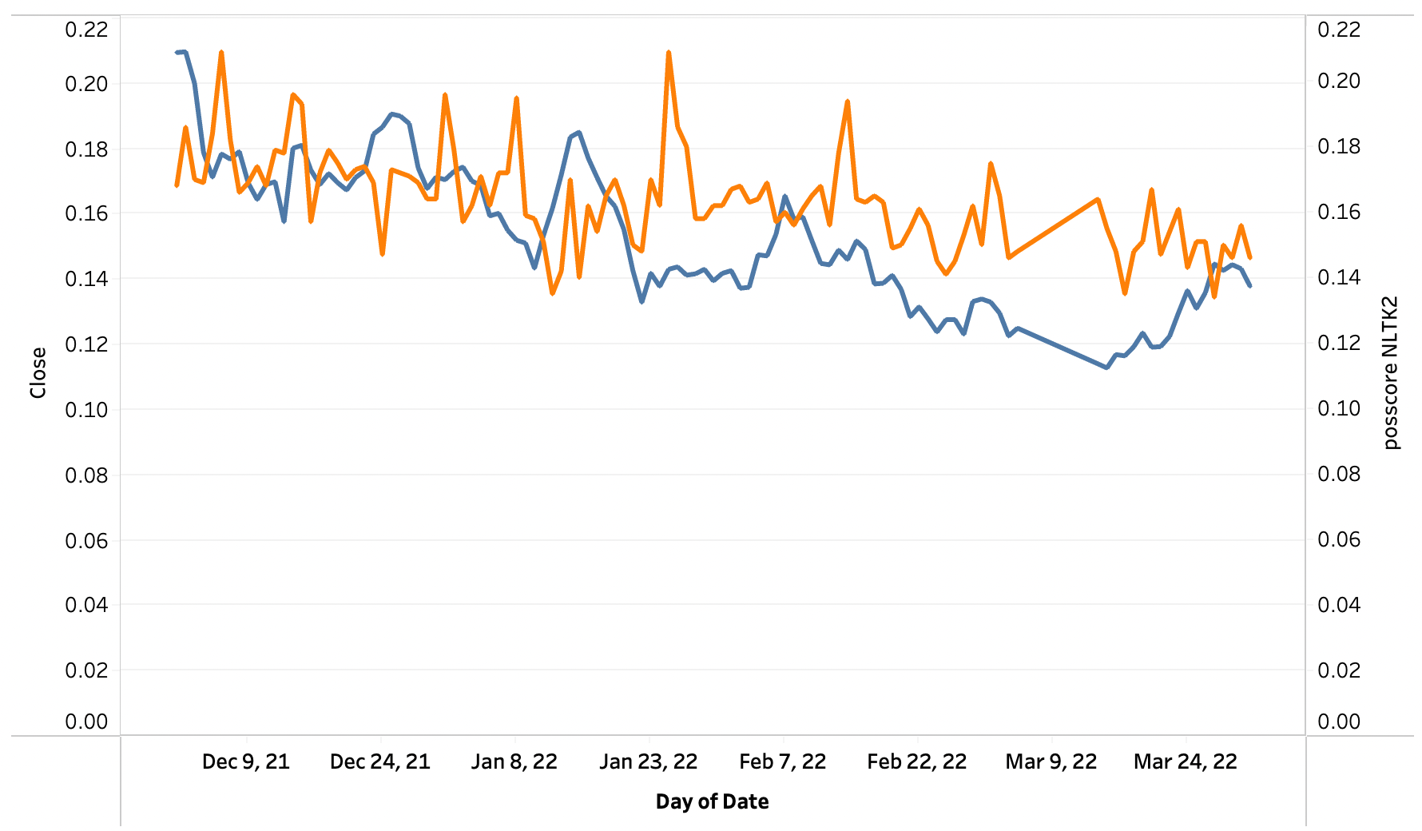
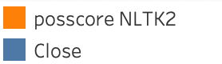
Positive nltk vs. real price
13

Slide 15
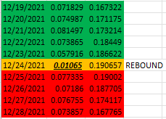
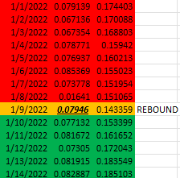
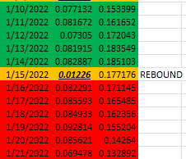
More interest idea, positive component score in real life practice

Slide 16

Results and Future Work
Model taking the historical price and VADER score showed the lowest RMSE.
Therefore, it can be concluded that combining the closing price with sentiment polarity is more efficient in predicting the dogecoin price
What is more, we found the postive component score is very usful in terms of dertimine huge price change, this might consider use as investment strategy in the future.
The study can be further expanded by including a new feature with news sentiment analysis that can prove to be more promising in terms of higher accuracy and lower error
14

Slide 17
Reference
https://machinelearningmastery.com/multivariate-time-series-forecasting-lstms-keras/
https://www.analyticsvidhya.com/blog/2020/10/multivariate-multi-step-time-series-forecasting-using-stacked-lstm-sequence-to-sequence-autoencoder-in-tensorflow-2-0-keras/
https://machinelearningmastery.com/reshape-input-data-long-short-term-memory-networks-keras/
https://www.youtube.com/watch?v=kGdbPnMCdOg&t=2589s
https://eudl.eu/pdf/10.4108/eai.29-9-2021.171188
15

Slide 18
Thank you

